Slide 1

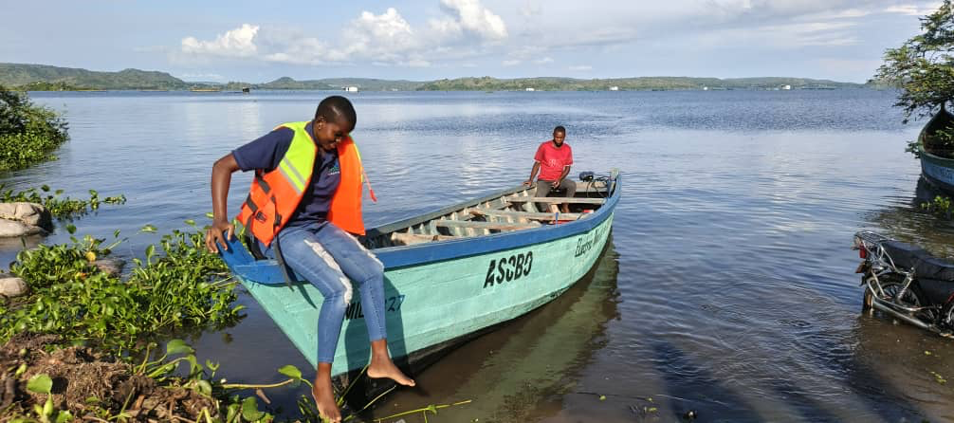

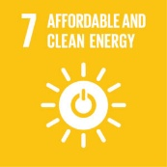


The
Story
Electric mobility on the water – fishing boats on Lake Victoria

Slide 2
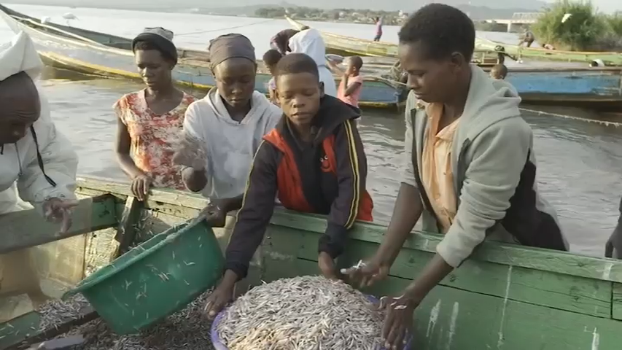
Environmental and social impact of fishing on Lake Victoria
50 million people whose livelihoods are directly or indirectly dependent on fishing at Lake Victoria

Slide 3
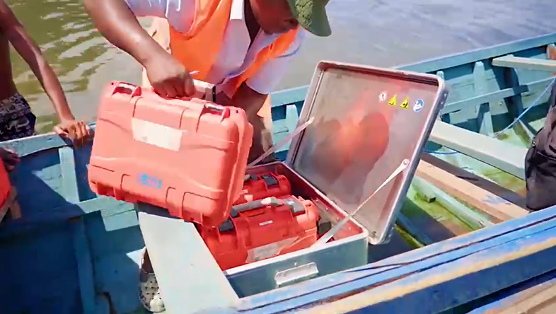
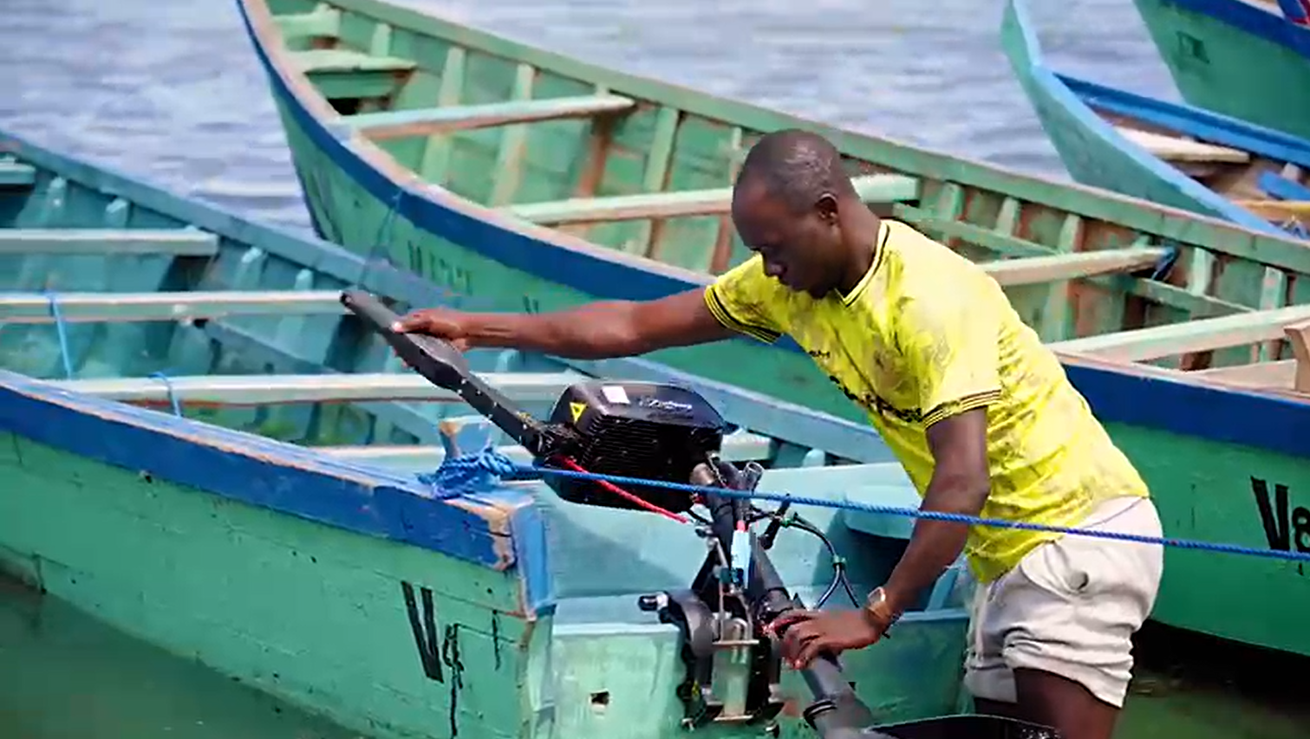
Igombe Living Lab for e-mobility on the water
5.240 fishing trips completed with ASOBO e-mobility

Slide 4
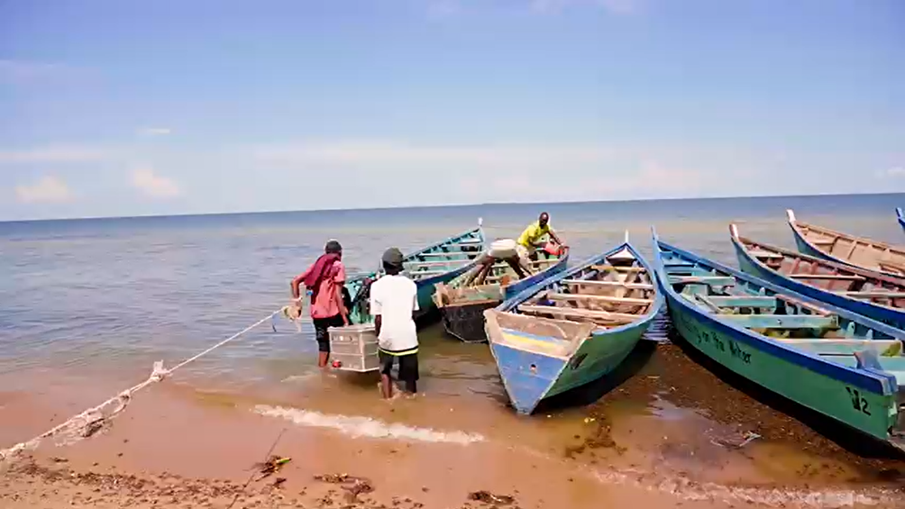
Environmental and economical impact of
e-mobility fishing
Petrol propulsed fishing boats
CO₂
2.4 kg/l petrol
4.000 l/a
9.6 t CO₂/a/boat
25% less than the monthly expense of running a petrol powered outboard

Slide 5
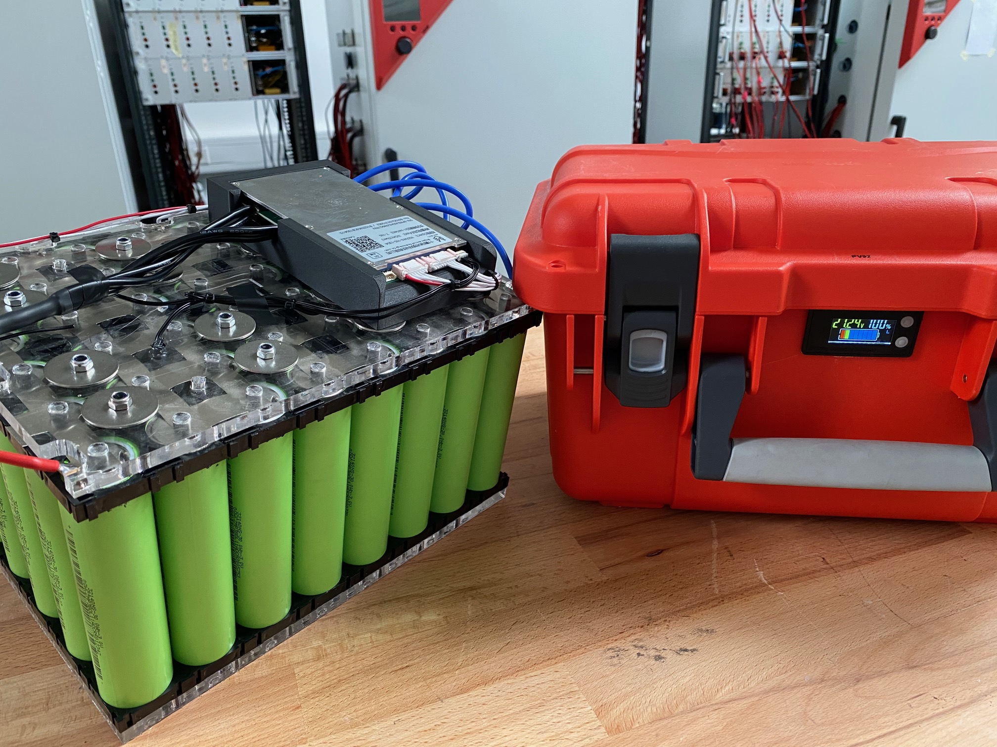
Innovative sodium-ion-battery technology
SodiumX power box
24 V, 1.5 kWh for electric propulsion

Slide 6
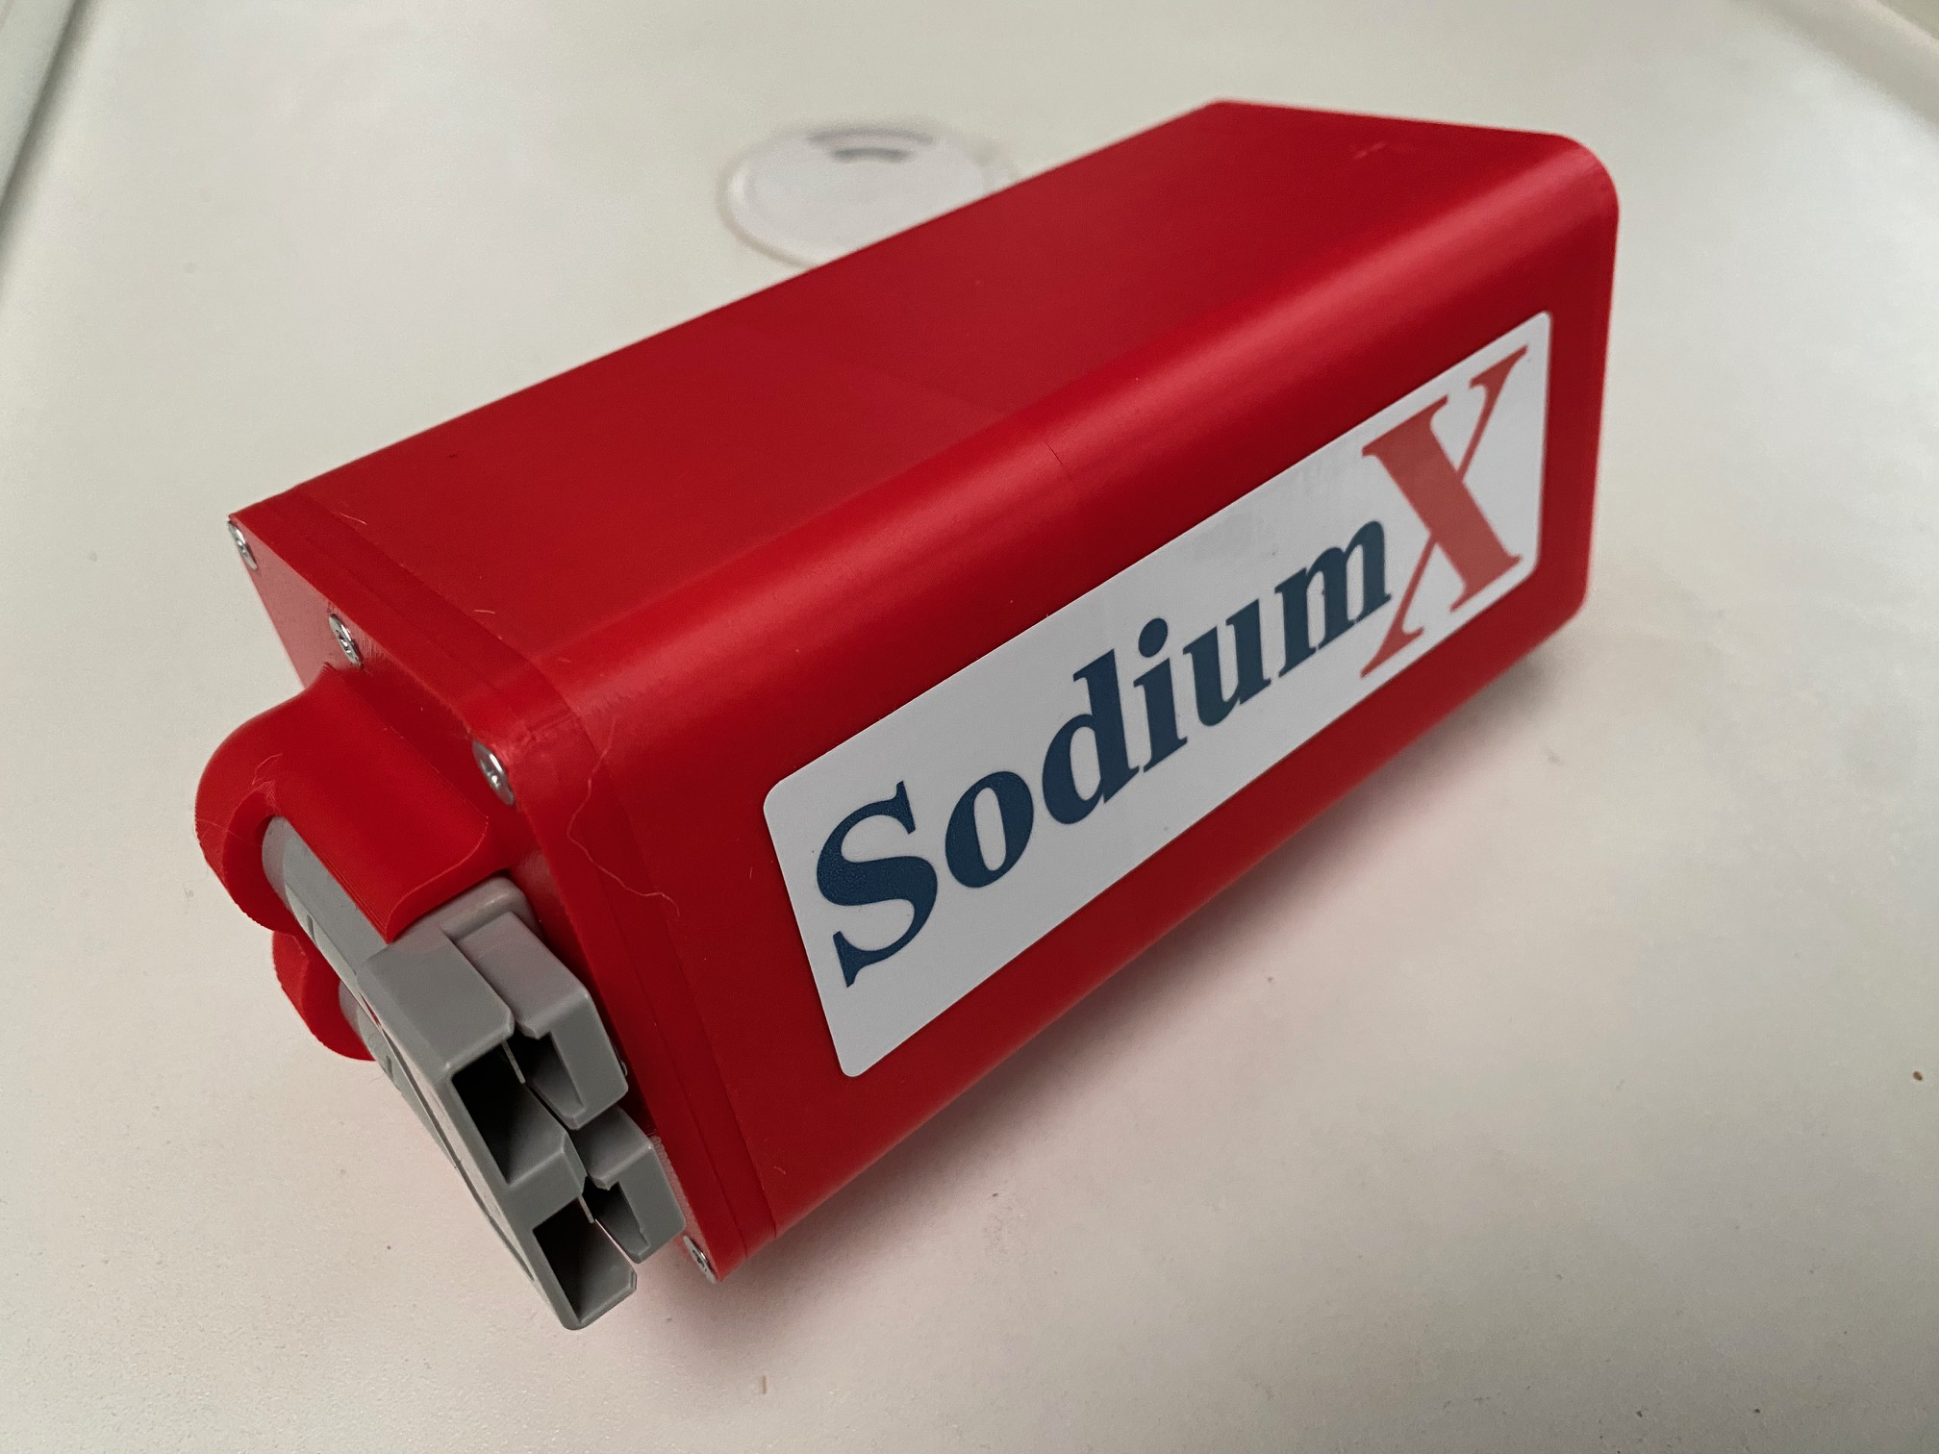
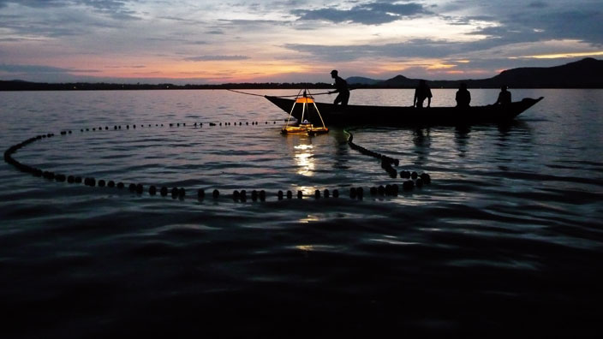
Dagaa-LED fishing batteries
Lead-acid 12V/10Ah
SodiumX 12V/10Ah
Lead-acid battery 25,- USD
25 USD/year (lifetime less than 1 year)
SodiumX sale price 30,- USD
10 USD/year (guarantee 3 years)

Slide 7
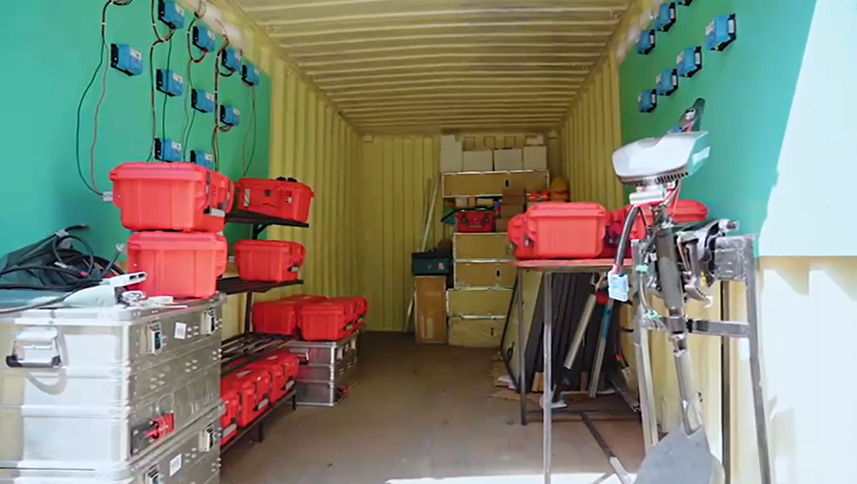
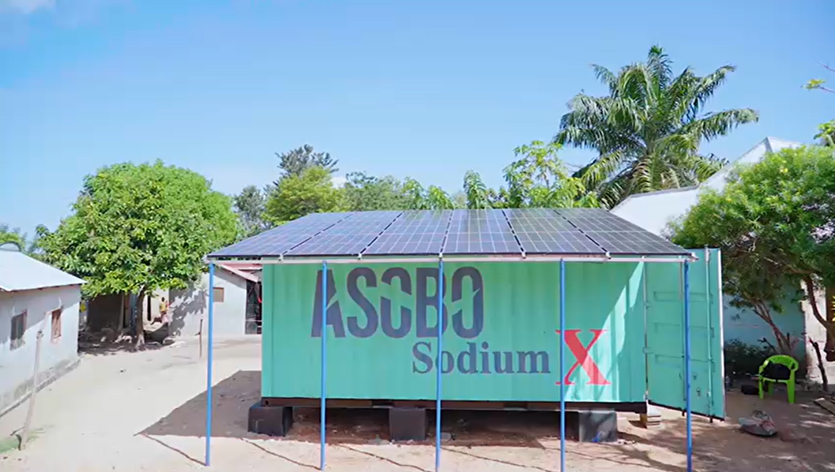
Solar charging stations around Lake Victoria

Slide 8
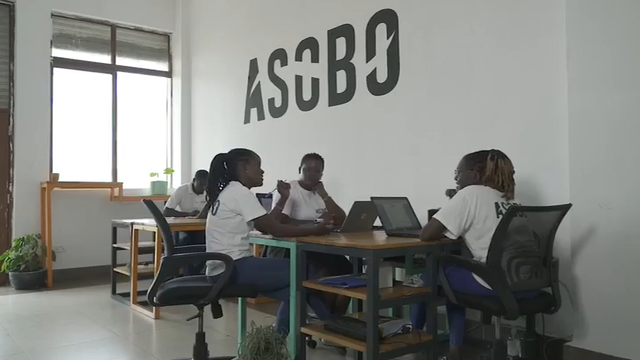
E-mobility customer training and service

Slide 9

Impact of e-mobility fishing

Slide 10


